Slide 1














PYTHON
GROUP - 06
PROJECT
-STUDENTS' PERFORMANCE-

Slide 2


01.
INTRODUCTION & PROJECT OBJECTIVES
P.J.E.Jebasuthanthirany 10900340
02.
DATA SET OVERVIEW & DATA CLEANING
Joshua 10900339
03.
METHODOLOGY & OUTLIER DETECTION
G.h.s.gnanodya 10899472
04.
EXPECTED DELIVERABLES & VISUALIZATION
Malki Amasha 10899282
05.
CONCLUSION & STATISTICAL ANALYSIS
TABLE OF
CONTENT
Kavithma Samadinie 10899192

Slide 3



INTRODUCTION: OVERALL PROJECT OBJECTIVE
MAIN OBJECTIVE
SECONDARY OBJECTIVES
Also, students' performance is influenced by various factors (our variables)
Enhance teaching strategies to improve the outcomes of the students' performance.
P.J.E.Jebasuthanthirany 10900340

Slide 4





The objective is to extract insights using data cleaning, preprocessing, visualization, and modeling techniques in Python.
01.
Introduction
Ultimately, the project aims to provide valuable insights for educational institutions to enhance
02.
This section introduces the project and outlines its objectives. It highlights the goal of analyzing a dataset containing student performance data in math, reading, and writing scores
teaching methods and improve student outcomes.
03.
P.J.E.Jebasuthanthirany 10900340

Slide 5
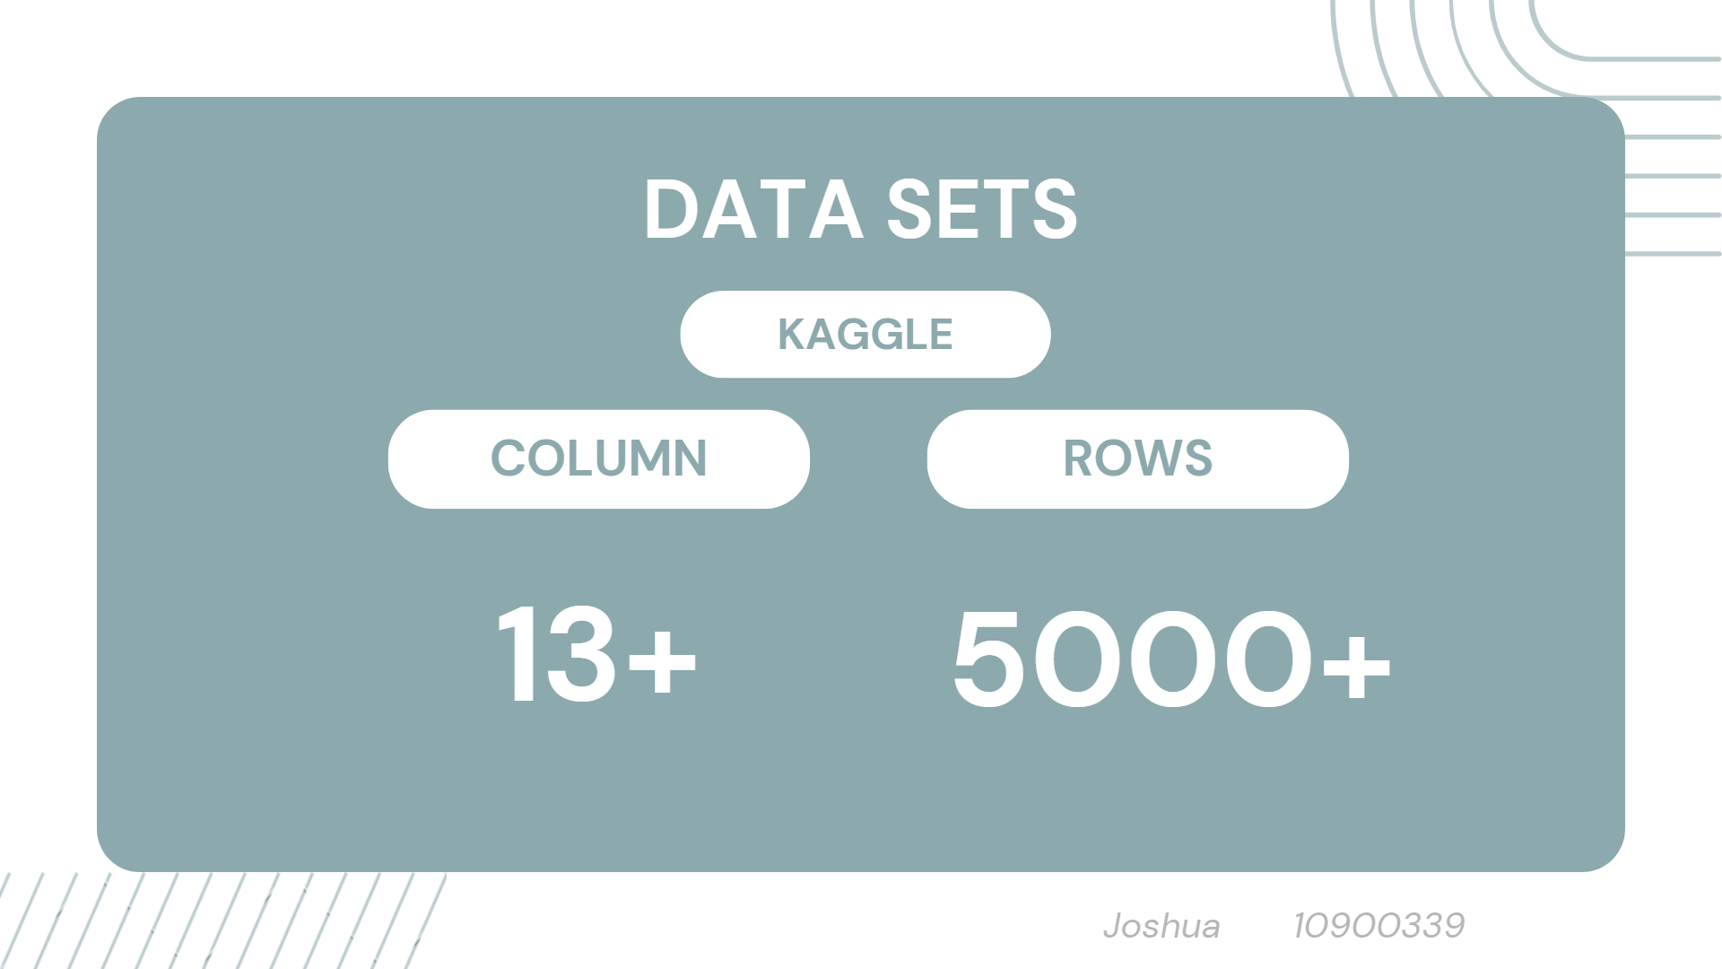

Slide 6





TO BE DROP
Dataset Overview
01. Name
02. City
03. Parent occupation
04. Mobile number
female 52%
male 48%
Null 10
group C 32%
group D 26%
Other 42%
Null 50
some college 23%
associate's degree 22%
Other 55%
standard 65%
free/reduced 36%
Joshua 10900339

Slide 7
Dataset Overview
06. Gender
07. Race/
Ethnicity
08. Parental level of education
09. Lunch
female 52%
male 48%
Null 10
group C 32%
group D 26%
Other 42%
Null 50
some college 23%
associate's degree 22%
Other 55%
standard 65%
free/reduced 36%
Joshua 10900339

Slide 8
Dataset Overview
10. Test preparation course
11. Math
score
12. Reading score
13. Writing score
group C 32%
group D 26%
Other 42%
Null 50
some college 23%
associate's degree 22%
Other 55%
standard 65%
free/reduced 36%
female 52%
male 48%
Null 10
Joshua 10900339

Slide 9
DATA CLEANING
01 - HANDLING MISSING VALUES
02 - REMOVING DUPLICATES
These methods helps to ensure that the dataset is accurate, consistent, and suitable for analysing and modeling tasks.
03 - HANDLING DUPLICATE DATA
04 - STANDARDIZING FORMATS
Joshua 10900339

Slide 10
METHODOLOGY
01 - Outlier detection
IDENTIFIES DATA POINTS THAT DEVIATE SIGNIFICANTLY FROM THE NORM, AIDING IN ANOMALY IDENTIFICATION AND DATA QUALITY ASSURANCE.
02 - data visualization
REPRESENTS INFORMATION GRAPHICALLY TO UNCOVER PATTERNS, TRENDS, AND INSIGHTS WITHIN DATASETS, FACILITATING INTUITIVE COMPREHENSION AND DECISION-MAKING.
03 - statistical analysis
EMPLOYS MATHEMATICAL TECHNIQUES TO EXPLORE, SUMMARIZE, AND INTERPRET DATA, ENABLING INFERENCE, HYPOTHESIS TESTING, AND DECISION SUPPORT IN RESEARCH AND PROBLEM-SOLVING.
G.h.s.gnanodya 10899472

Slide 11

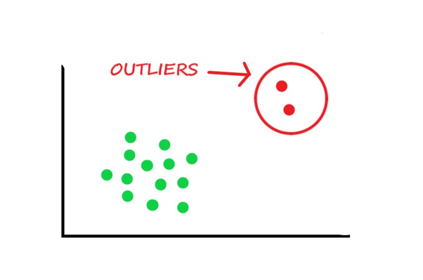
identifying data points that diverge significantly from the rest of the dataset
OUTLIER DETECTION
Ethicsaiding in anomaly detection and data quality assessment
recognizing aberrations that may distort statistical analyses or machine learning models.
G.h.s.gnanodya 10899472

Slide 12
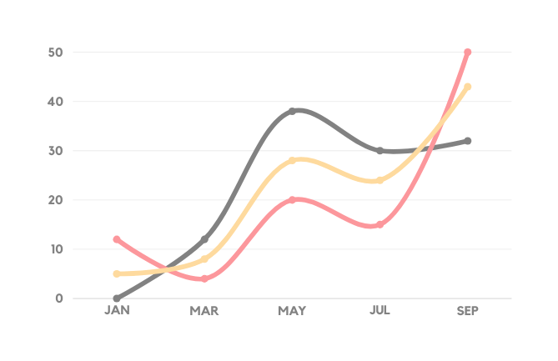
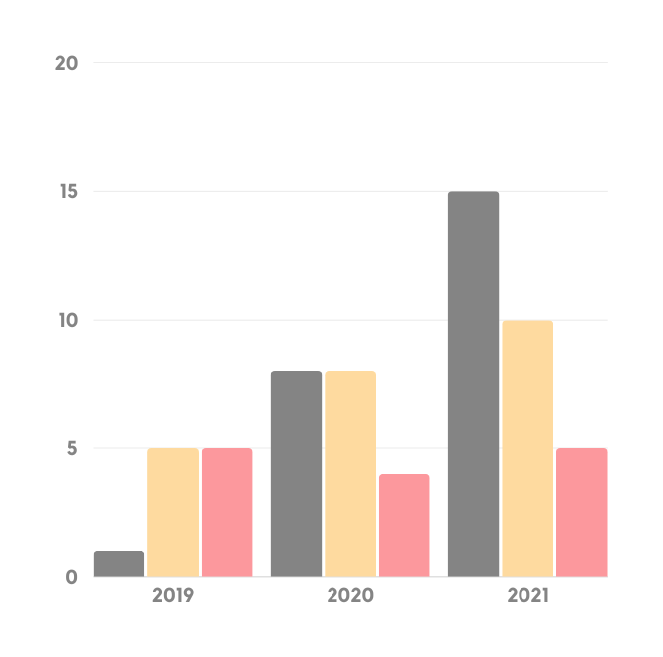
EXPECTED DELIVERABLES
01 -Visualization plots illustrating data distribution and relationships
02 - Outlier detection report
03 - Predictive models for forecasting student performance
04 - Statistical analysis results
MALKI AMASHA 10899282

Slide 13





Importance of Visualization
provide insights
understanding data patterns
The significance of visualization lies in its ability to provide insights from the dataset, aiding in understanding data patterns, trends, and relationships, thereby facilitating informed decision-making and effective communication of findings.
Visualization
Trends
relationships
Facilitating decision-making
Malki Amasha 10899282

Slide 14
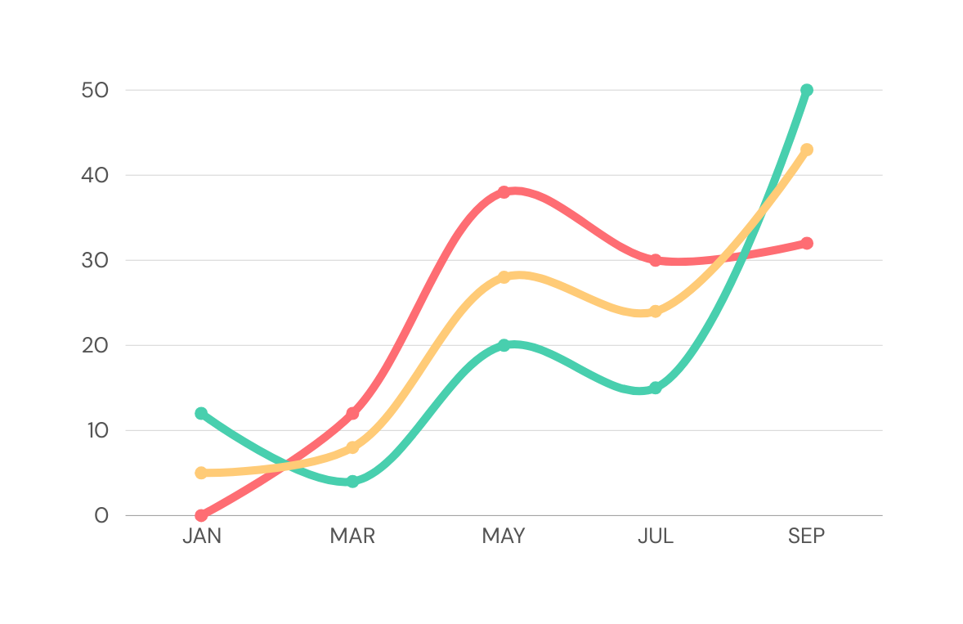

STATISTICAL ANALYSIS
01 - CALCULATING MEAN
02 - CONFIDENCE INTERVALS
03 - Z-CRITICAL VALUES
04 - MINIMUM
05 - IQR
06 - MAXIMUM
Kavithma Samadinie 10899192

Slide 15
